Slide 1

Rowi Alfata

Slide 2
What is Pandas?
Pandas is a fast, powerful, flexible and easy to use open source data analysis and manipulation tool, built on top of the Python programming language.

Slide 3
Key Features
Fast and efficient DataFrame object with default and customized indexing.
Tools for loading data into in-memory data objects from different file formats.
Data alignment and integrated handling of missing data.
Reshaping and pivoting of date sets.
Label-based slicing, indexing and subsetting of large data sets.
Columns from a data structure can be deleted or inserted.
Group by data for aggregation and transformations.
High performance merging and joining of data.

Slide 4
Essential Concept
Series
Series is a one-dimensional array like structure with homogeneous data. For example, the following series is a collection of integers 10, 23, 56, …
Homogeneous data
Size Immutable
Values of Data Mutable

Slide 5
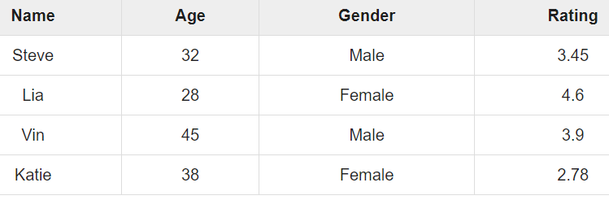
Essential Concept
DataFrame
DataFrame is a two-dimensional array with heterogeneous data.
Heterogeneous data
Size Mutable
Data Mutable

Slide 6
What will we learn?
Data loading
Selecting/Indexing
Filtering
Sorting
Mutating/conditionally adding columns
Groupby/summarize

Slide 7
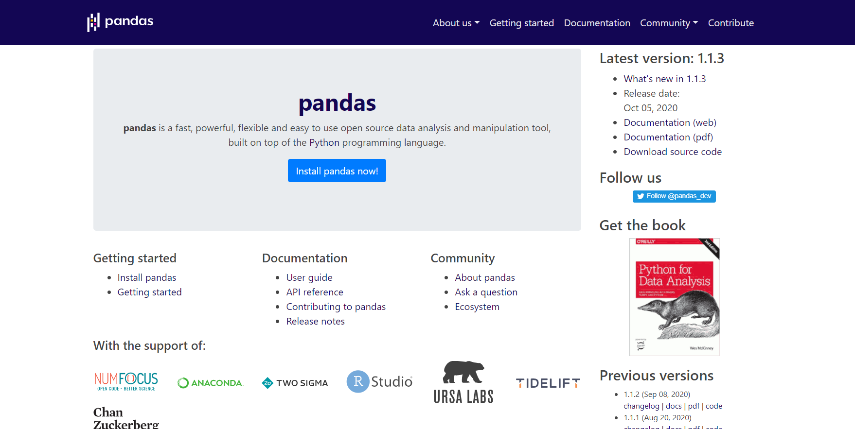
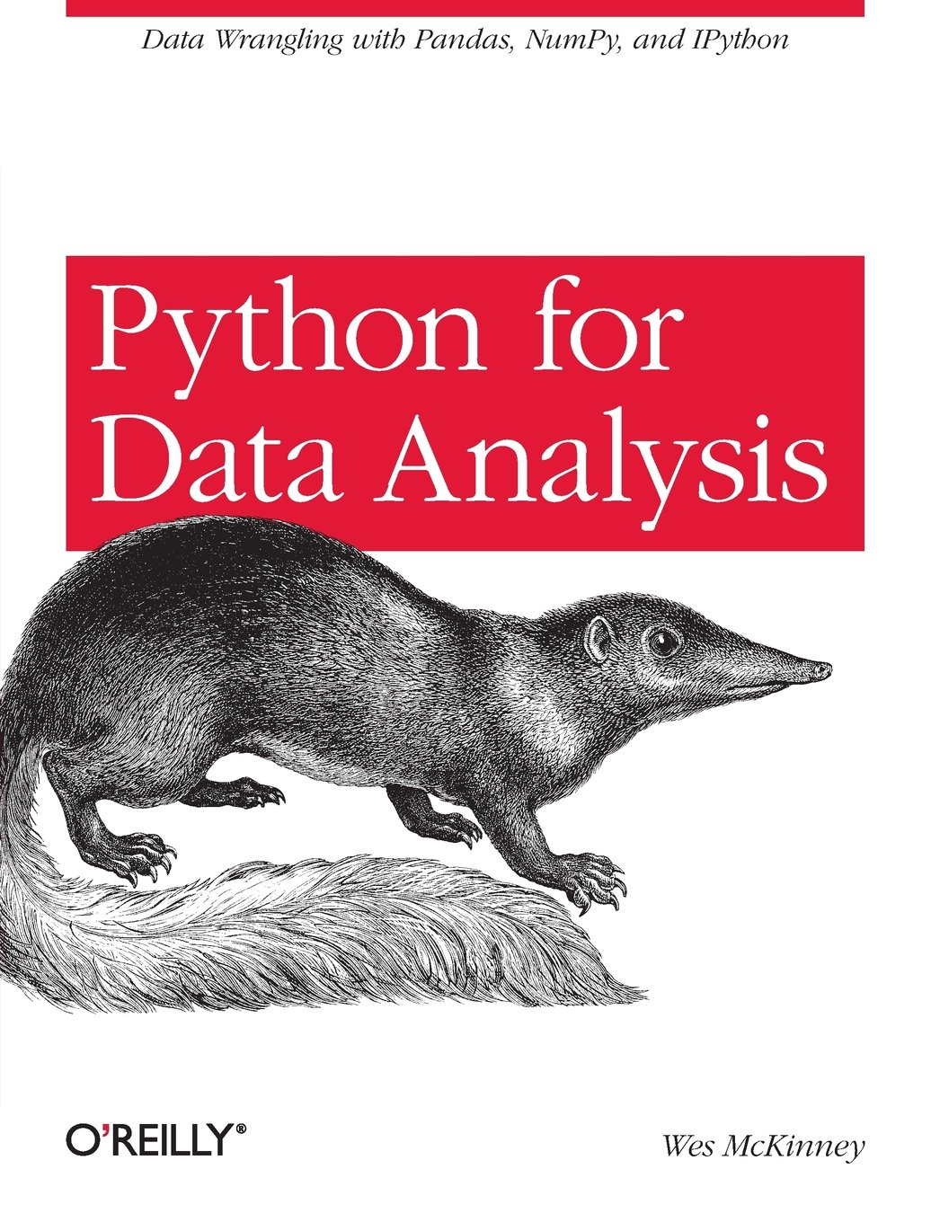
Resources
Python for Data Analysis
(Wes McKinney)
https://pandas.pydata.org/

Slide 8
Let’s get started….

Slide 9
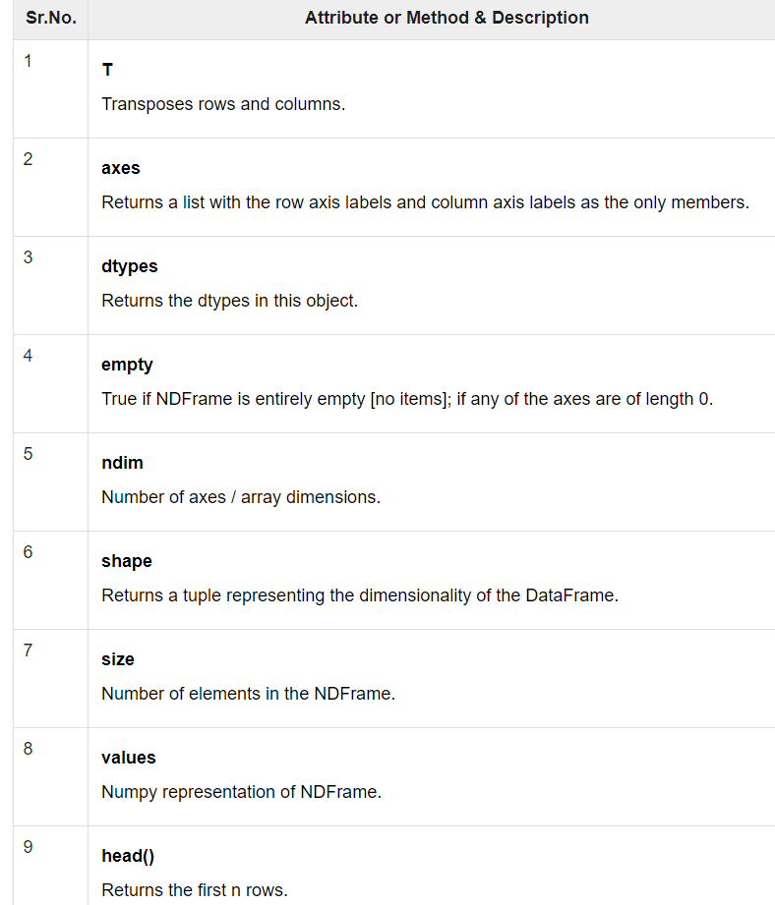
DataFrame Basic Functionality

Slide 10
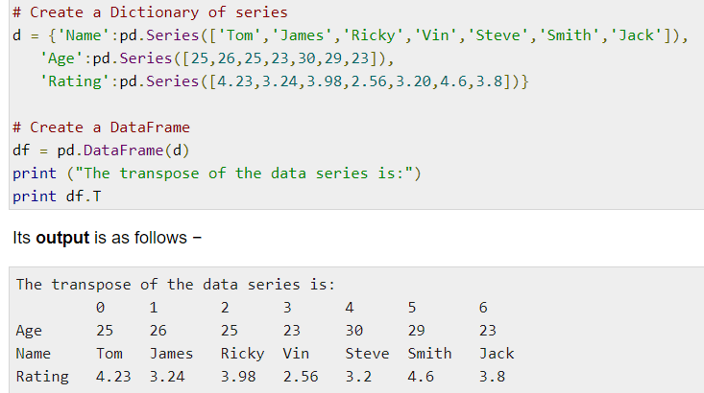
T (transpose)
Returns the transpose of the DataFrame. The rows and columns will interchange.

Slide 11
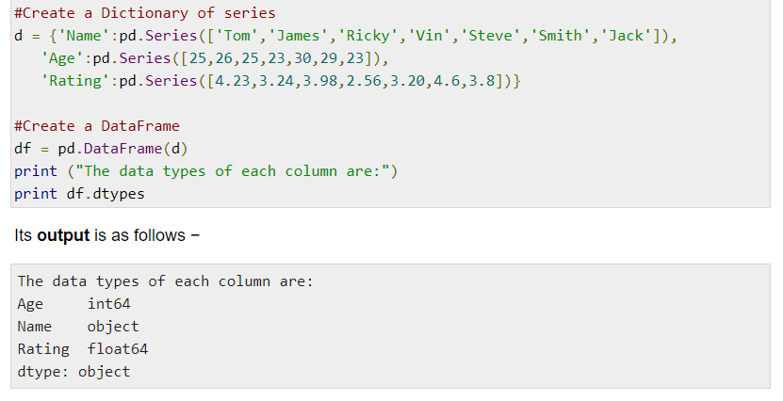
dtypes
Returns the data type of each column.

Slide 12
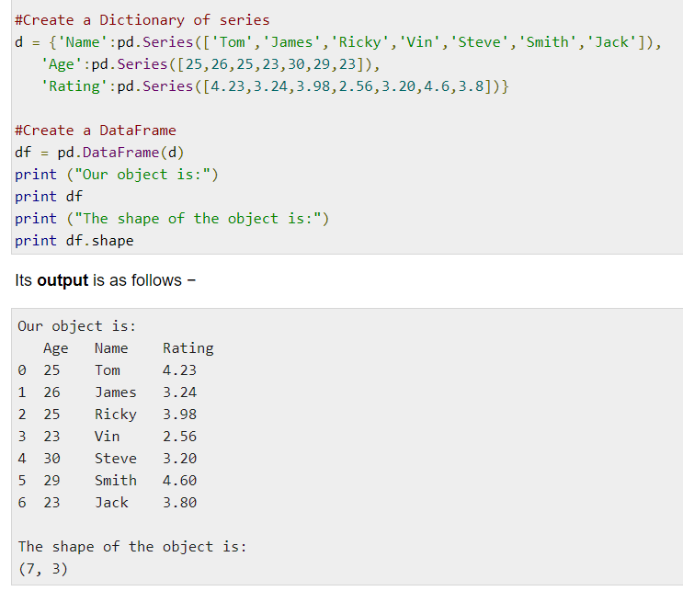
shape
Returns a tuple representing the dimensionality of the DataFrame. Tuple (a,b), where a represents the number of rows and b represents the number of columns.

Slide 13
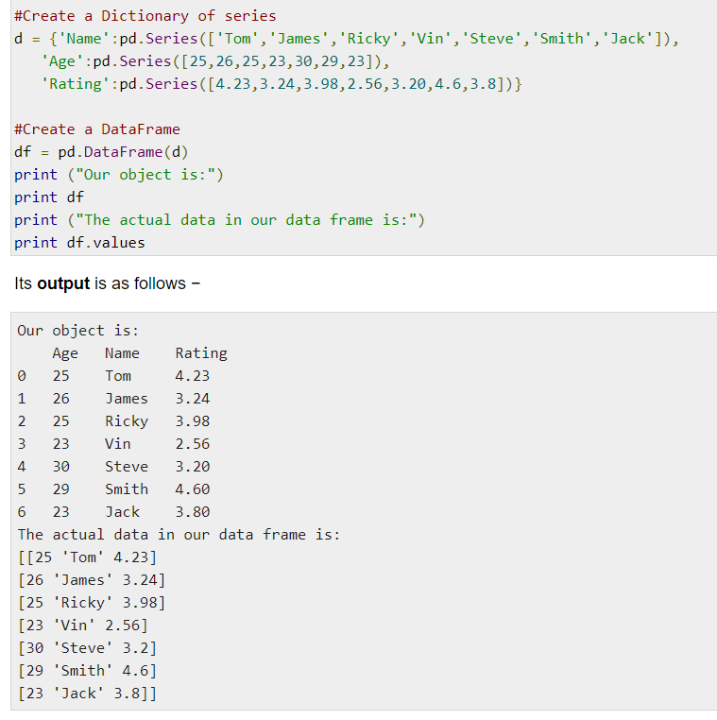
values
Returns the actual data in the DataFrame as an NDarray.

Slide 14
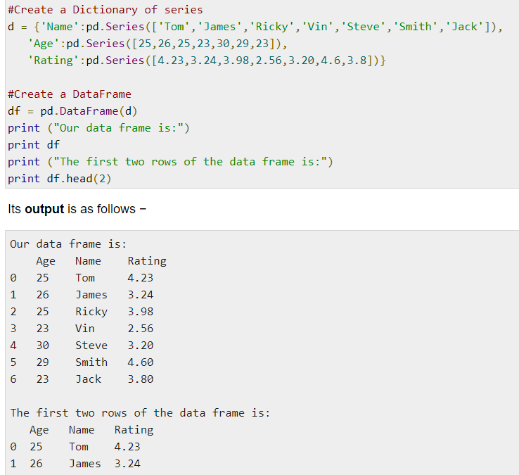
Head & tail
To view a small sample of a DataFrame object, use the head() and tail() methods. head() returns the first n rows (observe the index values). The default number of elements to display is five, but you may pass a custom number.

Slide 15
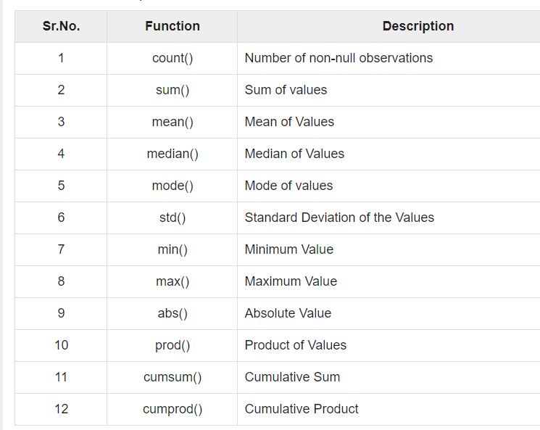
Functions

Slide 16
Exercise
Create the following dataframe and convert “Umur” into object
Nama | Umur | Kelas
Ahmad | 12 | 6
Joko | 13 | 7
Adi | 15 | 8

